Slide 1
MEGALITHIC MONUMENTS
SANTIAGO BURGALETA

Slide 2
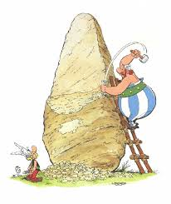
MEGALITHIC MONUMENTS
. MEGALITHIC MONUMENTS WERE BUILT FOR FUNERARY ACTIONS AND BECAUSE OF THE RELIGION.
. BUILDING THIS WAS NOT EASY BECAUSE LOTS OF PEOPLE DIED BECAUSE OF HOW HEAVY THE MONUMENTS WERE.AND WHEN ONE OF THEM FELL ON YOU IT WAS VERY EASY TO DIE.

Slide 3
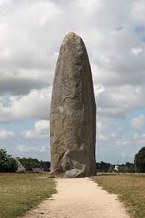
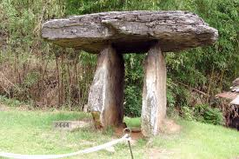
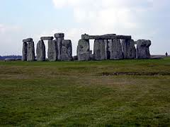
TYPES
THERE ARE THREE TYPES OF MEGALITHIC MONUMENTS:
MENHIR
DOLMEN
CROMLECH

Slide 4
THE STONEHENGE CROMLECH
THE MOST FAMOUS CROMLECH IS THE STONEHENGE CROMLECH.
IT`S SITUATED AT GREAT BRITAIN IN AMESBURY.
IT`S ONE THE MOST FAMOUS BECAUSE IT IS ALMOST COMPLETED AND IN GOOD CONDITION
IT CONTAINS BETWEEN 25 AND 30 COLUMNS AND EACH OF THEM WEIGHS 25 T.

Slide 5
STONEHENGE

Slide 6
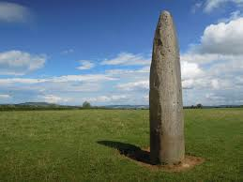
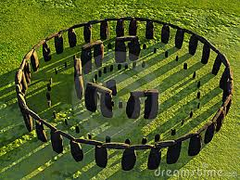
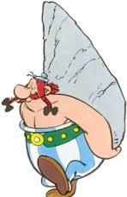
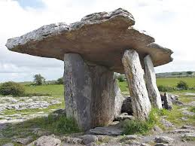
hghub

Slide 7
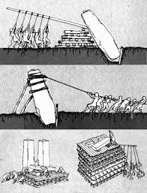
gkh
CONSTRUCTION OF MONUMENTS

